Slide 1


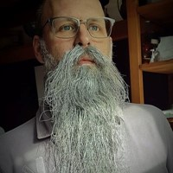




Speaker
Rob Sewell
Think PowerShell and SQL is meh? Meet dbatools!
Azure Arc-Enabled Data Services Introduction
Rob Sewell
sqldbawithbeard
September 16th & 17th
^{Online Event}
Powered By
International Conference

